Slide 1

INSTITUTE - UIE
DEPARTMENT- ACADEMIC UNIT-2
Bachelor of Engineering (Computer Science & Engineering)
Subject Name: Introduction to Problem Solving
Code:22CSH-101
Structure: Structure and functions, Structures and pointers
DISCOVER . LEARN . EMPOWER

Slide 2


Introduction to Problem Solving
Course Objectives
The course aims to provide exposure to problem-solving through programming.
The course aims to raise the programming skills of students via logic building capability.
With knowledge of C programming language, students would be able to model real world problems.

Slide 3



Course Outcomes
CO Number | Course Outcome
CO1 | Remember the concepts related to fundamentals of C language, draw flowcharts and write algorithm/pseudocode.
CO2 | Understand the way of execution and debug programs in C language.
CO3 | Apply various constructs, loops, functions to solve mathematical and scientific problem.
CO4 | Analyze the dynamic behavior of memory by the use of pointers.
CO5 | Design and develop modular programs for real world problems using control structure and selection structure.

Slide 4
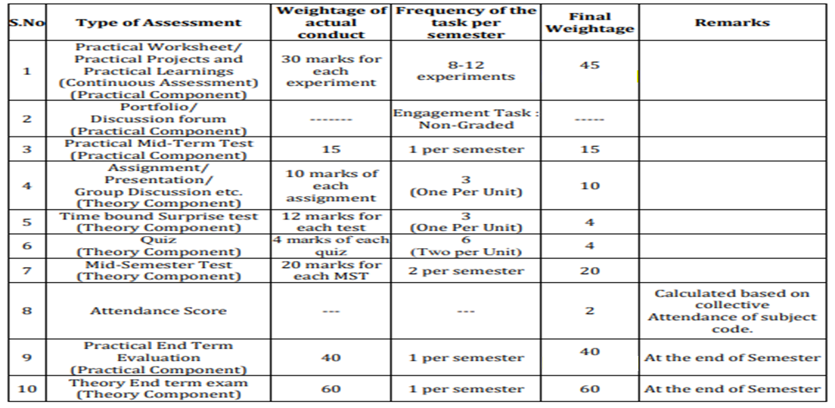
Scheme of Evaluation

Slide 5
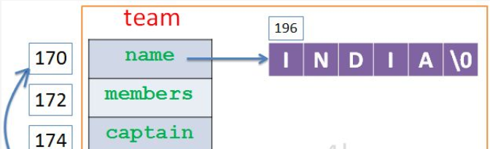
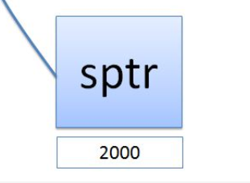
Structure and Pointers
Pointer to structure: Pointer which stores address of structure is called as “Pointer to Structure “.
Explanation :
sptr is pointer to structure address.
-> and (*). both represents the same.
These operators are used to access data member of structure by using structure’s pointer.

Slide 6
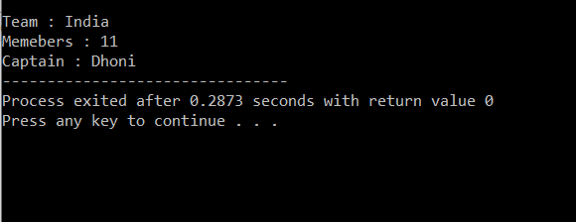
Example: Program to create a structure and display the content using pointer.
#include<stdio.h>
struct team {
char *name;
int members;
char captain[20];
}
t1 = {"India",11,"Dhoni"} , *sptr = &t1;
int main()
{
printf("\nTeam : %s",(*sptr).name);
printf("\nMemebers : %d",sptr->members);
printf("\nCaptain : %s",(*sptr).captain);
return 0;
}
Output:

Slide 7
Summary
Structure definition will be available within the function only.
A structure can be passed to any function from main function or from any sub function.
It won’t be available to other functions unless it is passed to those functions by value or by address
We can also initialize the array of structures using the same syntax as that for initializing arrays.
To access members of a structure using pointers, we use the -> operator.
Else, we have to declare structure variable as global variable. That means, structure variable should be declared outside the main function. So, this structure will be visible to all the functions in a C program.

Slide 8
Frequently Asked Questions
Q1 Write a Program to enter the employee Information & display the data passing Structures By Using Pointers
Expected Output:
Enter the name of the Employee : John
Enter the Employee Id : 16
Enter Experience of the Employee : 3
---------Details List---------
Employee Name : ram
Employee Id : 16
Employee Experience : 3
Solution:

Slide 9
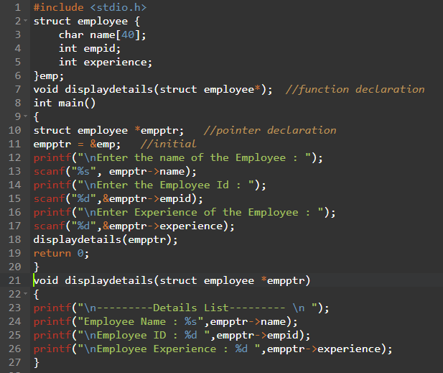

Slide 10
Assessment Questions:
1. Write a Program to demonstrate How to return multiple values from a function in C?
2. Program to add two distances in inch-feet system(Passing structure).

Slide 11

Discussion forum
PROBLEM:
Write a Program to add two complex numbers Using (Passing struct by reference).

Slide 12

REFERENCES
Reference Books
Programming in C by Reema Thareja.
Programming in ANSI C by E. Balaguruswamy, Tata McGraw Hill.
Programming with C (Schaum's Outline Series) by Byron Gottfried Jitender Chhabra, Tata McGraw Hill.
The C Programming Language by Brian W. Kernighan, Dennis Ritchie, Pearson education.
Websites:
https://fresh2refresh.com/c-programming/c-passing-struct-to-function/
https://www.geeksforgeeks.org/how-to-pass-or-return-a-structure-to-from-a-function-in-c-c/
https://www.studytonight.com/c/pointers-to-structure-in-c.php
https://dev.to/mikkel250/structures-and-pointers-in-c-n6i
https://www.programiz.com/c-programming/c-structures-pointers
YouTube Links:
https://www.youtube.com/watch?v=4HC8X966Q5M
https://www.youtube.com/watch?v=VF40lxbXR_0

Slide 13
THANK YOU

